Slide 1
ELEMENT DATA LINK PROTOCOLS n
The Protocol in the data link layer are designed so that the layer can perform the basic functions like Framing, error control and Flow control
Simple Protocol
Stop-and- Wait Protocol

Slide 2
Simple Protocol
Simple Protocol is hypothetical protocol. Data Transmitting is carried out in one direction only. The transmission & receiving carried out in one direction only. The transmission & Receiving are always Ready & processing Time can be ignored.
In this Protocol, infinite Buffer Space is available & no error’s are occurring that is no damage Frames & no lost Frames

Slide 3
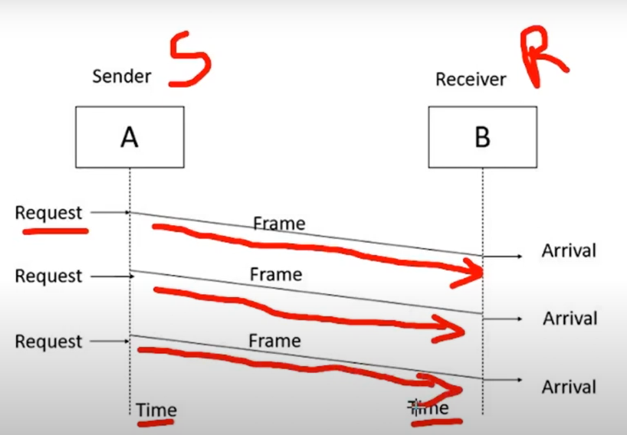

Slide 4
Stop-and- Wait Protocol
second protocol is called the Stop-and- Wait protocol, which uses both flow and error control. In this protocol, the sender sends one frame at a time and waits for an acknowledgment before sending the next one. To detect corrupted frames, we need to add a CRC to each data frame.
When a frame arrives at the receiver site, it is checked. If its CRC is incorrect, the frame is corrupted and silently discarded. The silence of the receiver is a signal for the sender that a frame was either corrupted or lost. Every time the sender sends a frame, it starts a timer.
If an acknowledgment arrives before the timer expires, the timer is stopped and the sender sends the next frame (if it has one to send). If the timer expires, the sender resends the previous frame, assuming that the frame was either lost or corrupted.
This means that the sender needs to keep a copy of the frame until its acknowledgment arrives. When the corresponding acknowledgment arrives, the sender discards the copy and sends the next frame if it is ready.

Slide 5
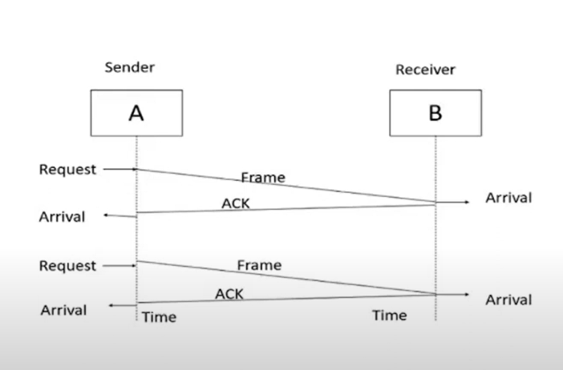

Slide 6
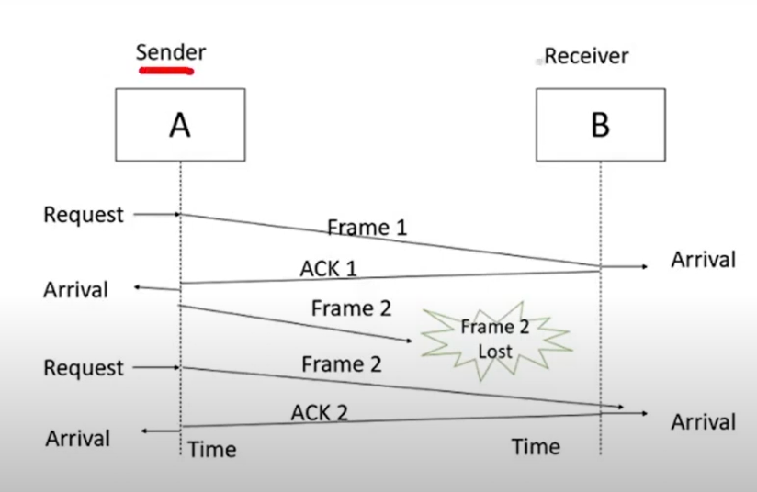

Slide 7
Simplex Protocol For Noisy Channel
Data Transfers only in one Direction, consider separate sender and receiver,finte processing capacity and speed at the receiver, since it is a noisy channel, errors in data frames are expected. Every Frame has it unique sequence number.
After a frame has been transmitted, the timer is started for a finite time. Before the time expires, if acknowledgement is not received, the frame gets retransmitted, when the acknowledgement gets corrupted, how long the sender should wait to transmit the next frame is infinite.

Slide 8
Sliding Window Protocol
The sliding window is a technique for sending multiple frames at a time. It controls the data packets between the two devices where reliable and gradual delivery of data frames is needed.
In this technique, each frame has sent from the sequence number. The sequence numbers are used to find the missing data in the receiver end. The purpose of the sliding window technique is to avoid duplicate data, so it uses the sequence number.
Types of Sliding Window Protocol
Sliding window protocol has two types:
1. Go-Back-N ARQ
2. Selective Repeat ARQ

